Slide 1
Project - 4
Implementation of Motion Planning on Baxter

Slide 2
Part-1 (5 Points)
Simulate path planning on Baxter in a simulated environment.
Task – pick a cylindrical object from a table and place it on the center of the other table while avoiding collision with the obstacles.
Either V-Rep or Gazebo can be used and the environment for the simulation will be provided to you
No need to implement your own planner, you can use planners provided by V-Rep (OMPL) and Gazebo (MoveIt!)
No coding is required
The submission for this project will be a video showing the motion generated using in-built path planners.

Slide 3
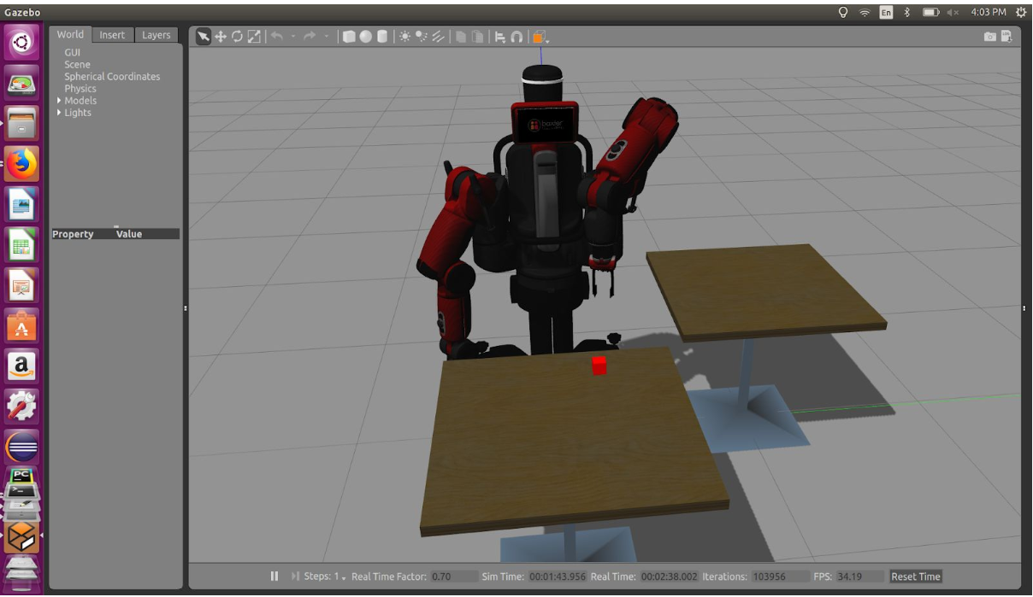
Part-1 continued…
Project-4 Environment in Gazebo

Slide 4
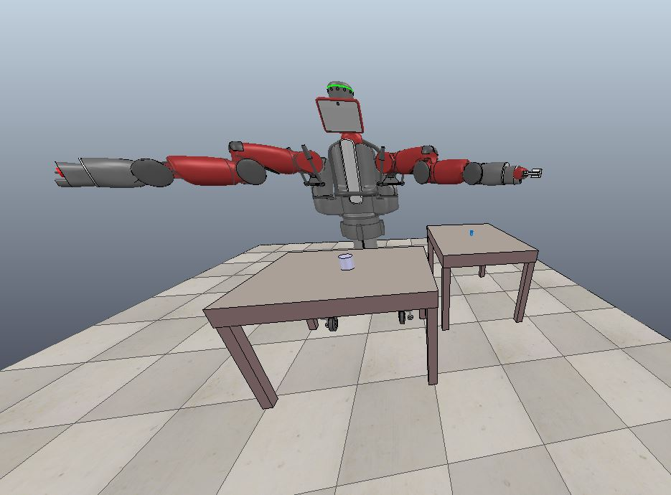
Part-1 continued…
Project-4 Environment in V-Rep

Slide 5
Part – 2 (2 points) Optional
Implement motion planning on a real robot
This part can be done either on turtlebot or on Baxter
Note - Those who are planning to implement this part on turtlebot should use the velocity text file from project-3. For the practical implementation, you have to use ROS. ROS accepts the velocity along x axis (linear velocity) and the z axis (Rotational velocity) so you have to make some changes in the velocity file if it is not in the correct format.

Slide 6
Resources-
For the simulation (in Gazebo) and implementation on real robot refer
1) ROS_Presentation & ROS_installation in session 03
2) http://sdk.rethinkrobotics.com/wiki/Baxter_Simulator
3) http://wiki.ros.org/Robots/TurtleBot/Network%20Setup

Slide 7
Resources-
For the simulation (in V-Rep) and implementation on real robot refer
V-Rep Tutorial in session 03
https://www.youtube.com/watch?v=yUUnHYF9Okw&list=PLugJxt6EeSk_yP61ZI_hmmhWc4JImFiS-&index=5
https://www.youtube.com/watch?v=dst1jVLUaxs&list=PLugJxt6EeSk_yP61ZI_hmmhWc4JImFiS-&index=1
https://www.youtube.com/watch?v=jISDu1tmxdI&index=3&list=PLugJxt6EeSk_yP61ZI_hmmhWc4JImFiS-
https://www.youtube.com/watch?v=aJSTvoHID4k&list=PLugJxt6EeSk_yP61ZI_hmmhWc4JImFiS-&index=4
https://www.youtube.com/watch?v=Zt21o1qsOB4
https://www.youtube.com/watch?v=DwCt0lVjx58

